Slide 1
Data Communication Components over Physical Layer
Data
Analog: Continuous value data (sound, light, temperature)
Digital: Discrete value (text, integers, symbols)
Signal
Analog: Continuously varying electromagnetic wave
Digital: Series of voltage pulses (square wave)
Transmission
Analog: Works the same for analog or digital signals
Digital: Used only with digital signals

Slide 2
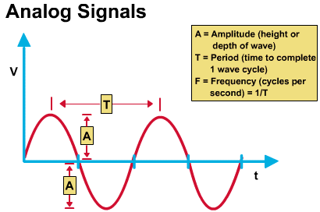
Analog vs. Digital Signals
Analog signals have a continuously varying voltage-versus-time graph

Slide 3
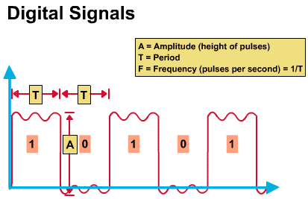
Analog vs. Digital Signals
Digital signals have a square wave with instant transitions from low to high voltage states (0 to 1)

Slide 4
Bit Rate, Bit Length, Baud rate
Bit Rate
The number of bits sent in 1 second
Unit: bps
Bit Length
The distance one bit occupies on the transmission medium
Unit: meter, micro meter, nano meter, etc.
Propagation speed x bit duration
Baud Rate
The number of signals sent in 1 second
Bit rate = Baud rate x n ( where n is the number of bits per signal)

Slide 5
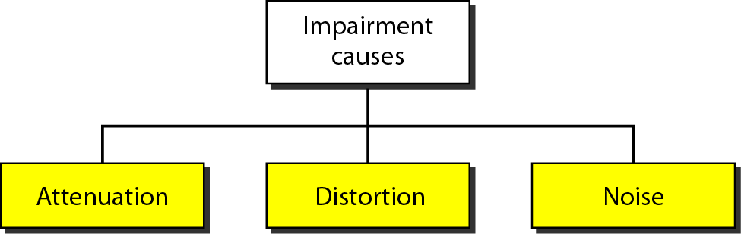
Transmission Impairment
Attenuation:
The decrease in magnitude of a signal as it travels through a transmission medium
Distortion:
Any undesired change in a signal during transmission (e.g. out of phase)
Noise:
An undesirable signal due to low-quality of a transmission medium, impeding the true signal

Slide 6
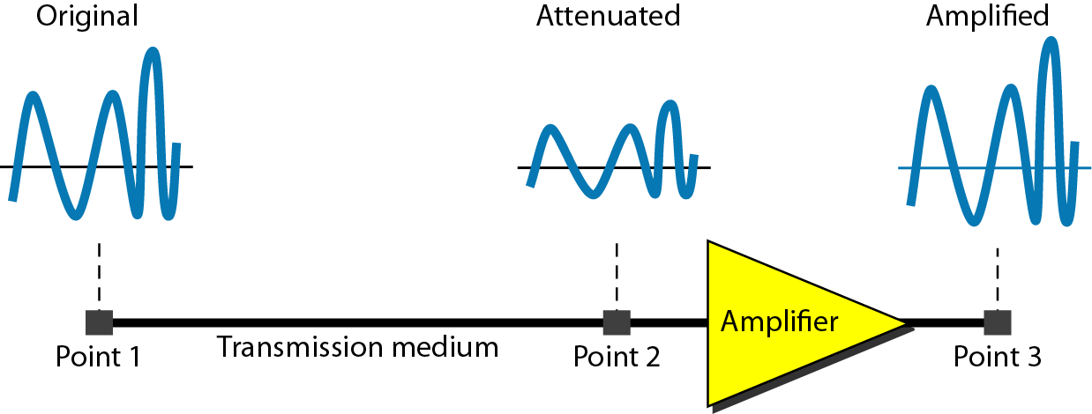
Figure 3.26 Attenuation

Slide 7
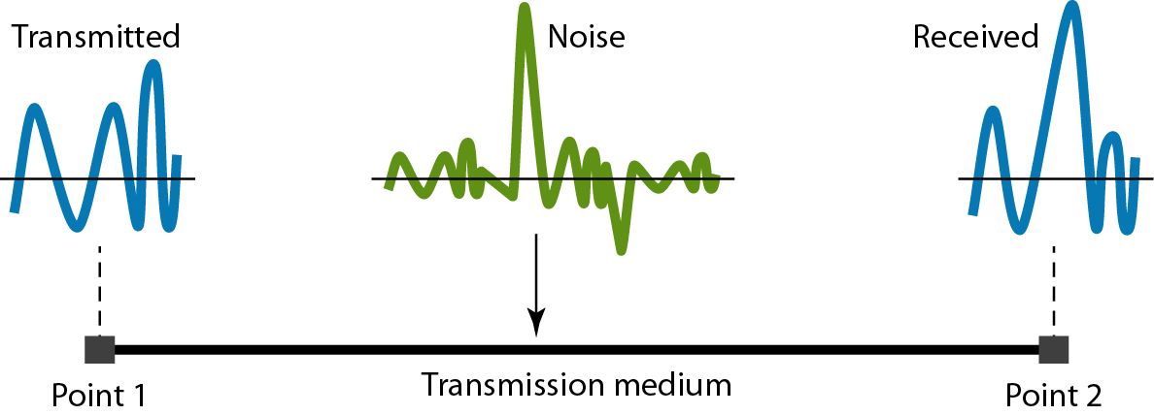
Figure 3.29 Noise

Slide 8
Signal-to-Noise (SNR) Ratio
SNR = Average Signal Power/Average Noise Power
SNR_{dB} = 10 log₁₀ SNR

Slide 9
Two Important Results on data rate, capacity:
Nyquist Theorem for a noiseless channel
Gives maximum theoretical bit rate
Shannon’s Law for a noisy channel
Gives an estimate on capacity

Slide 10
Bandwidth: two usage of the term
“analog” world: bandwidth in Hz
refers to range of frequencies (=high-low)
“digital” world: bandwidth in bits/sec
Refers to speed of bit transmission in a link
Nyquist & Shannon’s results gives us a rough idea on how to go between these two terms (noiseless/noise)
However, it doesn't’t tell us what coding was used (to be discussed later)

Slide 11
Nyquist’s Theorem
Aka the Sampling Theorem
D = 2B log₂ L
(D: Data rate, B: Bandwidth, L: signal levels)
If the sampling rate is less than 2xmax_freq, some of the highest frequency components in the analog input signal will not be correctly represented in the digitized output.

Slide 12
Shannon’s Law of a noisy channel
Noisy means the channel has noise; thus, need to incorporate signal-to-noise in estimating capacity
The capacity of a channel
= bandwidth x log₂ (1 + SNR)

Slide 13
Example: Combining Shannon & Nyquist
The Shannon capacity gives us the upper limit; the Nyquist formula tells us how many signal levels we need.
Consider a channel with a 1-MHz bandwidth. The SNR for this channel is 63. What are the appropriate bit rate and signal level?
Solution
First, we use the Shannon formula to find the upper limit.
For better performance choose something lower, 4 Mbps, for example. Thus, use the Nyquist formula to find the number of signal levels.

Slide 14

Note
If the available channel is a bandpass channel, we cannot send the digital signal directly to the channel; we need to convert the digital signal to an analog signal before transmission.

Slide 15
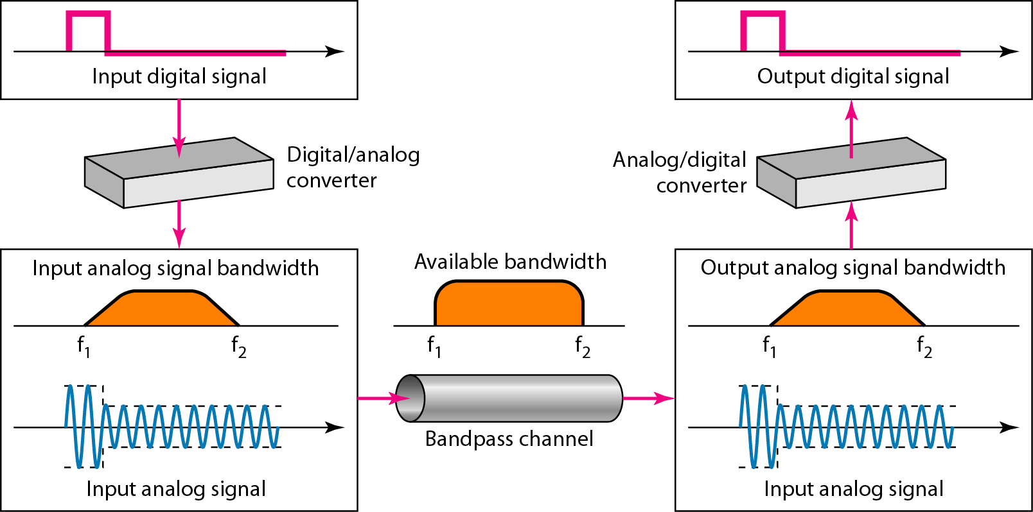
Figure 3.24 Modulation of a digital signal for transmission on a bandpass channel

Slide 16
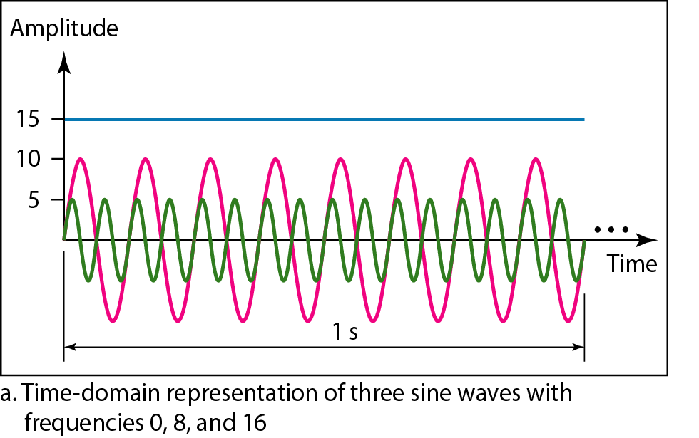
Convert the following into the Frequency-domain representation

Slide 17
Digital Transmission
Digital-To-Digital Conversion
Analog-To-Digital Conversion

Slide 18
Analog Data-->Signal Options
Analog data to analog signal
Easy conversion (eg telephone)
Used in traditional analog telephony
Analog data to digital signal
Requires a codec (encoder/decoder)
Allows use of digital telephony, voice mail

Slide 19
Digital Data-->Signal Options
Digital data to analog signal
Requires modem (modulator/demodulator)
Necessary when analog transmission is used
Digital data to digital signal
Less expensive when large amounts of data are involved
More reliable because no conversion is involved

Slide 20
Digital-to-digital Conversion
Line Coding: digital data to digital signals
Block Coding: mB/nB coding (optionally used)
Scrambling: to avoid long 0s (optionally used)

Slide 21
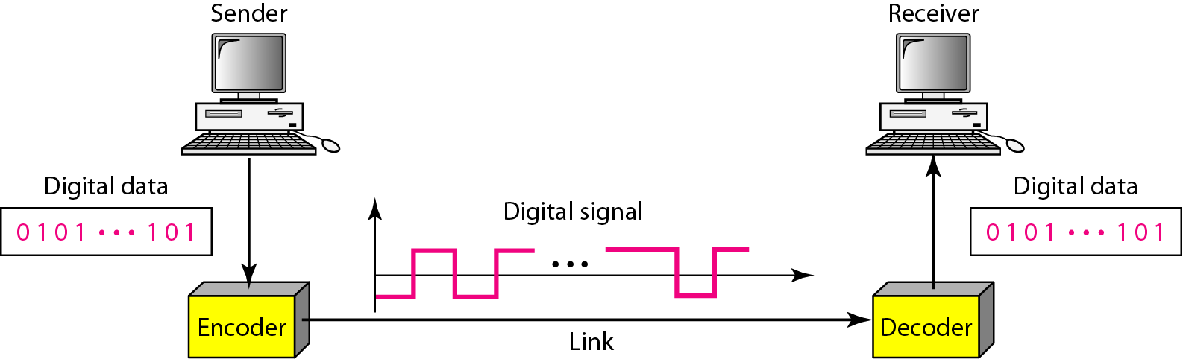
Figure 4.1 Line coding and decoding

Slide 22
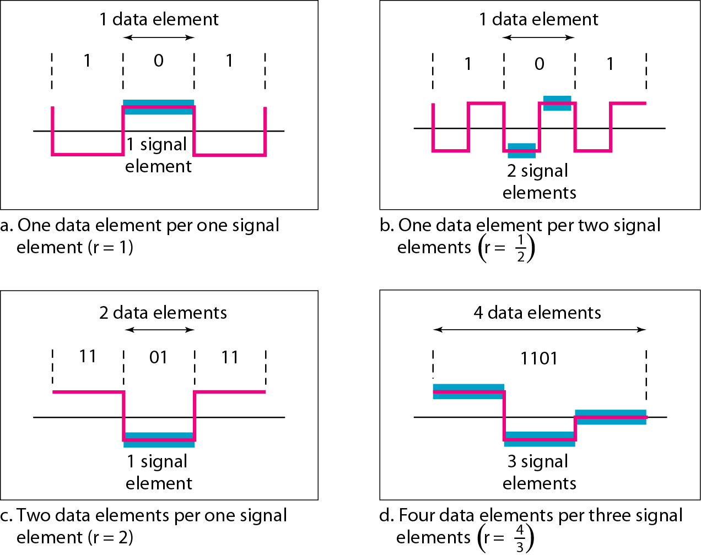
Figure 4.2 Signal element versus data element

Slide 23
Issues on Digital Transmission
Self-synchronization.
Clock skew between sender and receiver
Built-in error detection.
Immunity to Noise.
Complexity.
Needs time to interpret (2 levels vs. 64 levels)
Baseline Wandering.
In decoding digital signal, a running average (baseline) is used to evaluate the incoming signal power. Long 0s make the baseline down.
DC components

Slide 24
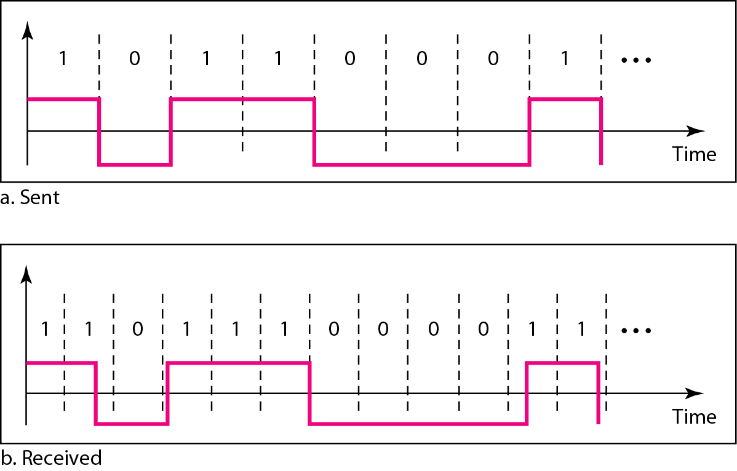
Figure 4.3 Effect of lack of synchronization

Slide 25
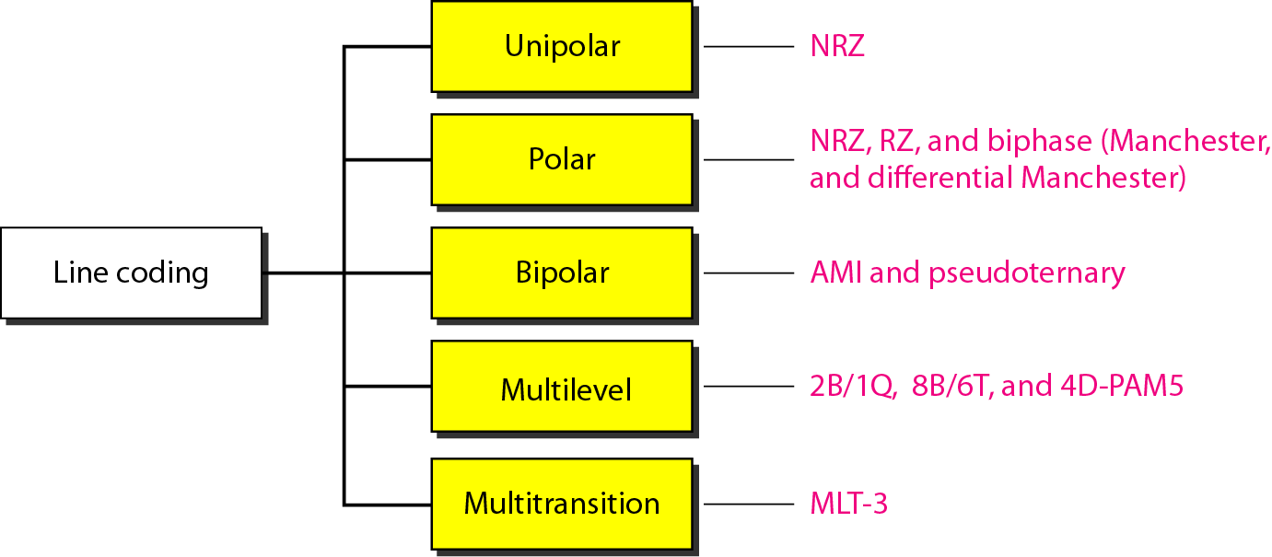
Figure 4.4 Line coding schemes

Slide 26
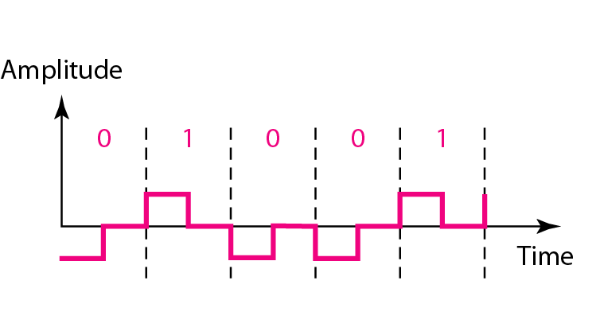
Figure 4.7 Polar RZ scheme

Slide 27
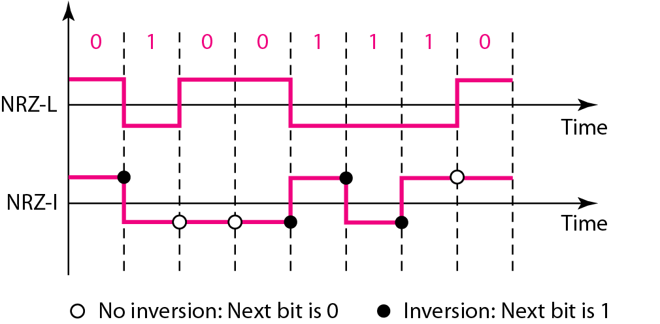
Figure 4.6 Polar NRZ-L and NRZ-I schemes

Slide 28
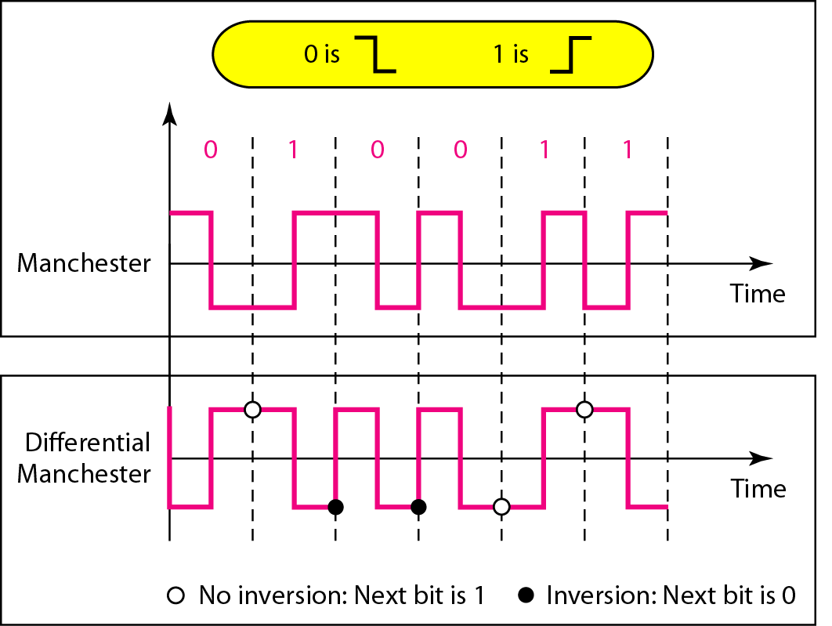
Figure 4.8 Polar biphase: Manchester and differential Manchester schemes

Slide 29
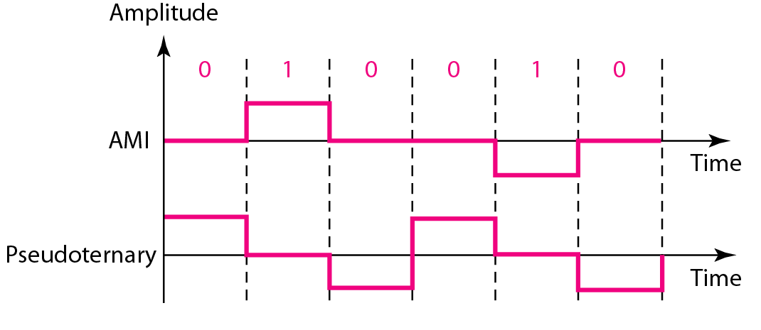
Bipolar schemes: Alternate Mark Inversion (AMI) and pseudoternary
Used by T1 with scrambling

Slide 30
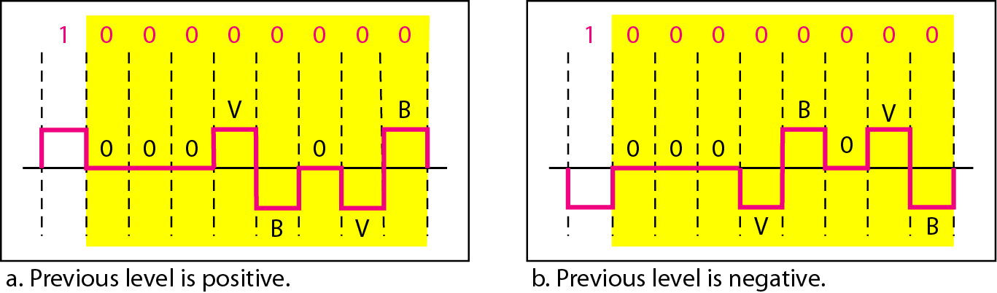
Figure 4.19 Two cases of B8ZS scrambling technique
B8ZS substitutes eight consecutive zeros with 000VB0VB.

Slide 31
Analog-To-digital Conversion
Pulse Code Modulation (PCM)
Delta Modulation (DM)

Slide 32
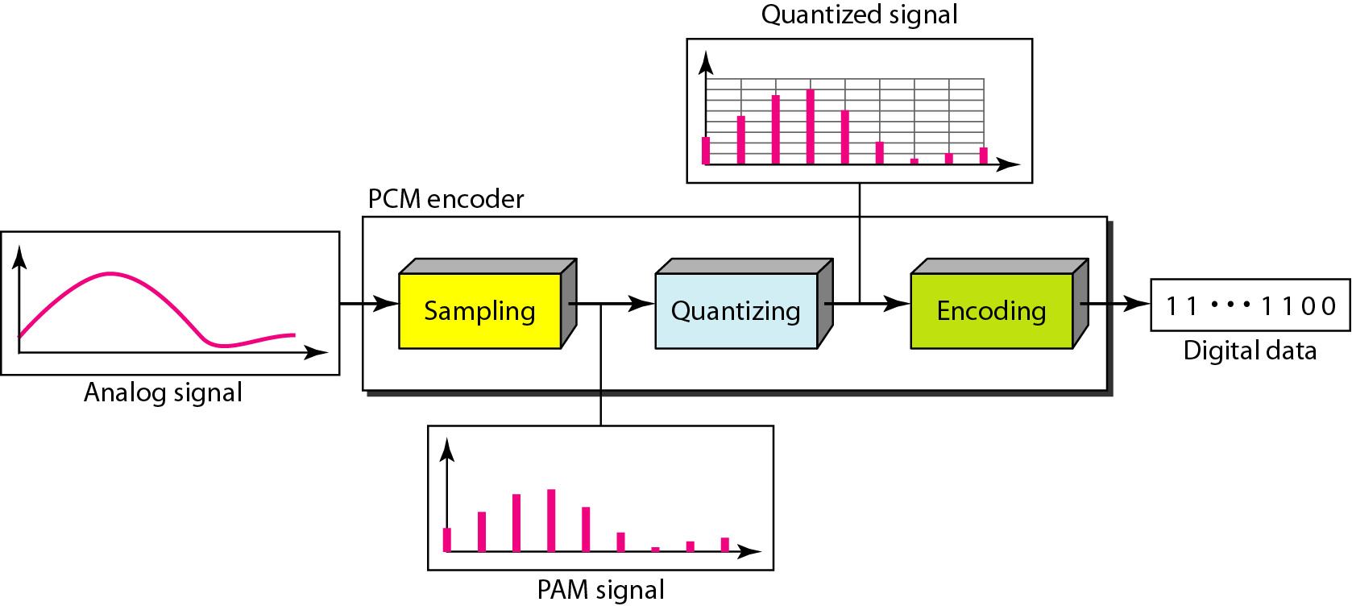
Figure 4.21 Components of PCM encoder

Slide 33
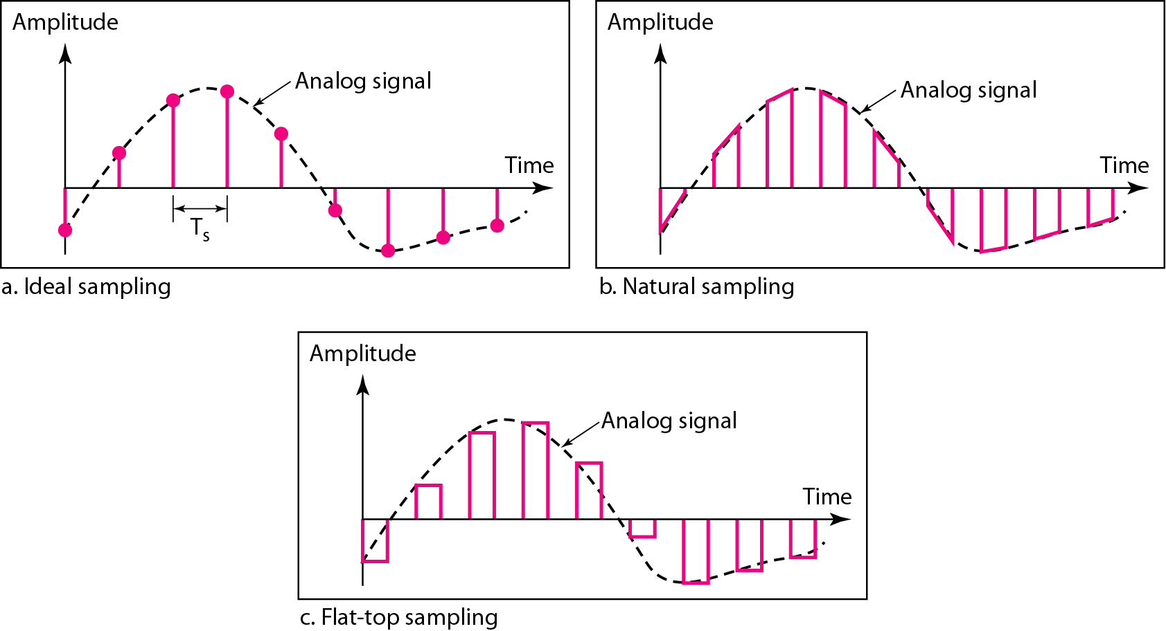
Figure 4.22 Three different sampling methods for PCM

Slide 34
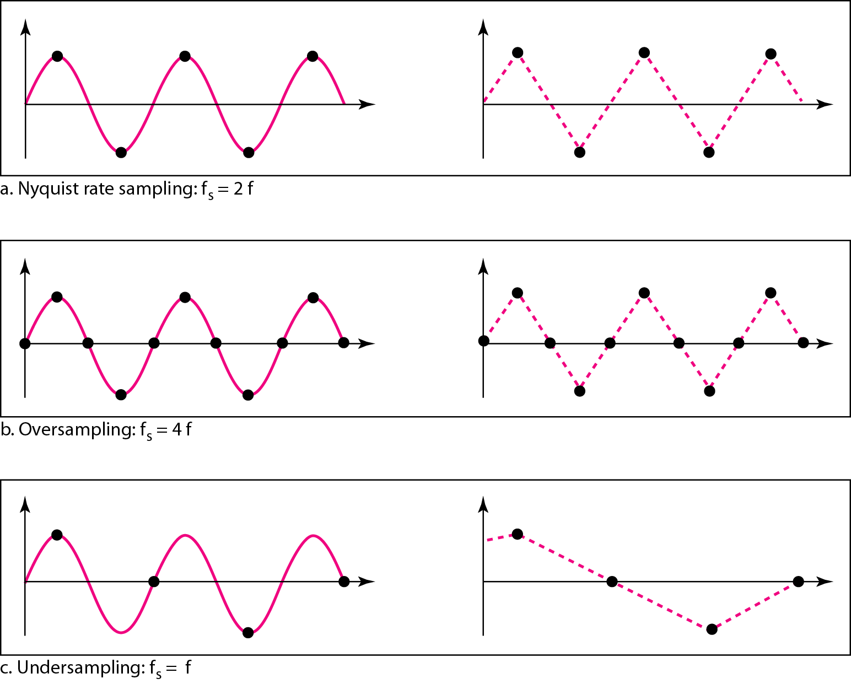
Figure 4.24 Recovery of a sampled sine wave for different sampling rates
According to the Nyquist theorem, the sampling rate must be
at least 2 times the highest frequency contained in the signal.

Slide 35
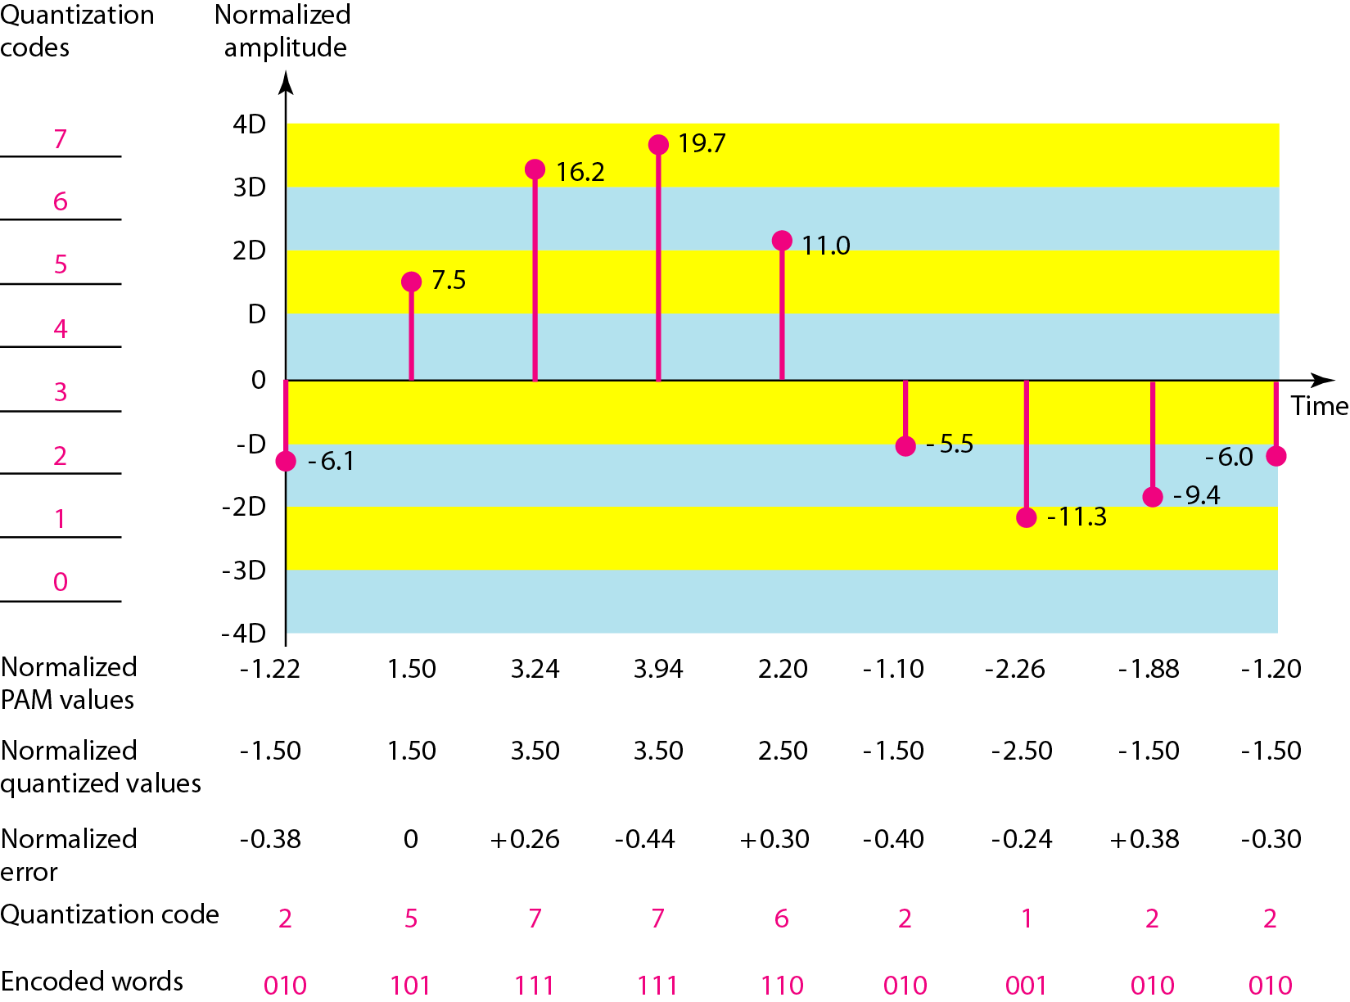
Figure 4.26 Quantization and encoding of a sampled signal

Slide 36
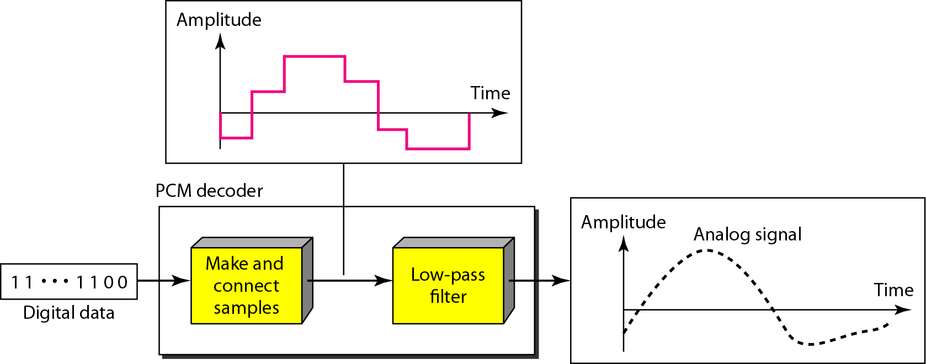
Figure 4.27 Components of a PCM decoder

Slide 37
Example 4.14
We want to digitize the human voice. What is the bit rate, assuming 8 bits per sample?
Solution
The human voice normally contains frequencies from 0 to 4000 Hz. So the sampling rate and bit rate are calculated as follows:

Slide 38
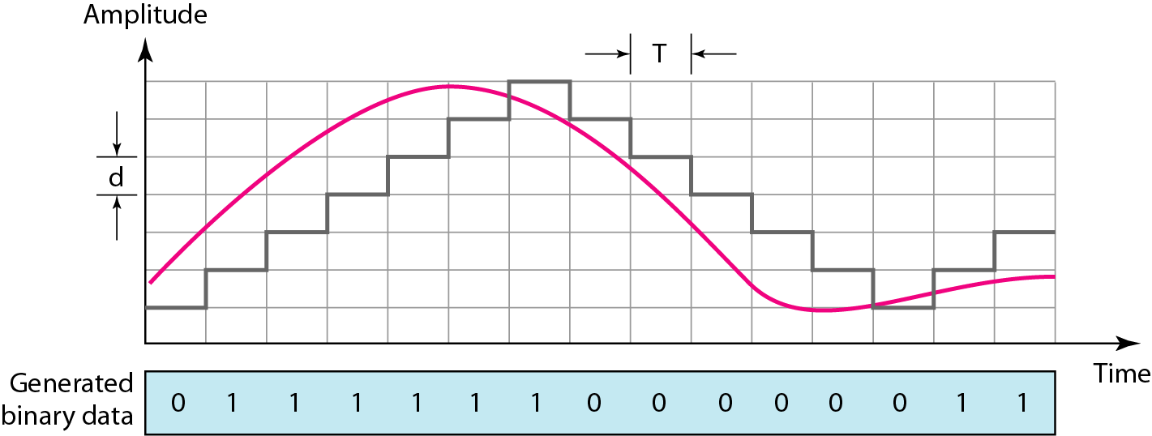
Figure 4.28 The process of delta modulation

Slide 39
Analog Transmission
Digital-To-Analog Conversion
Analog-To-Analog Conversion

Slide 40
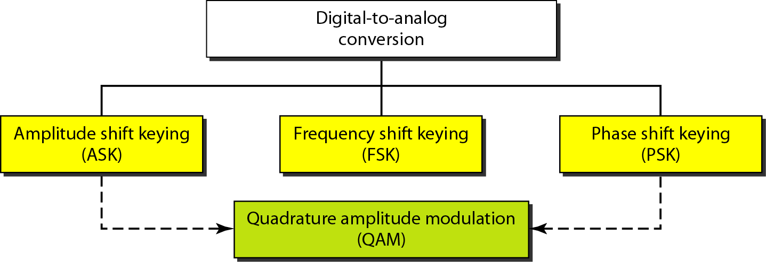
Digital-To-Analog Conversion

Slide 41
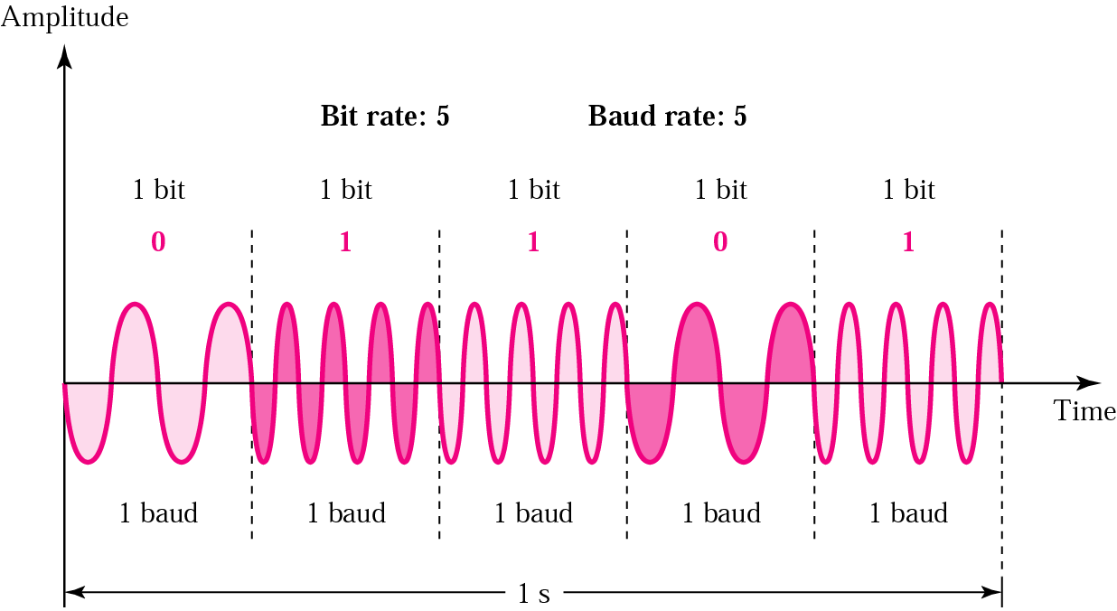
Figure 5.6 FSK

Slide 42
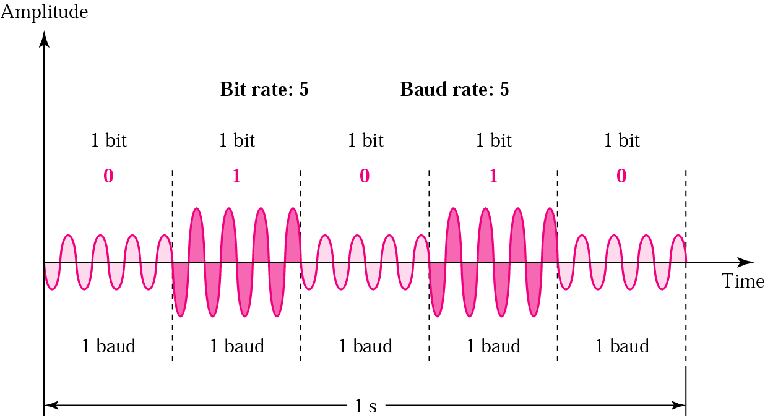
Figure 5.3 ASK

Slide 43
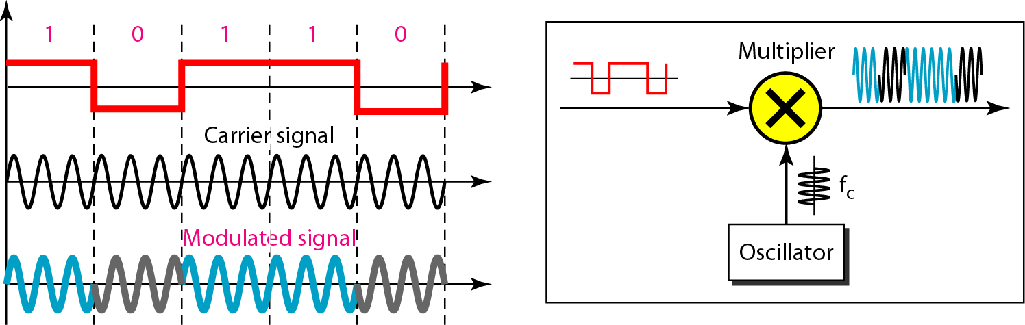
Figure 5.10 Implementation of BPSK

Slide 44
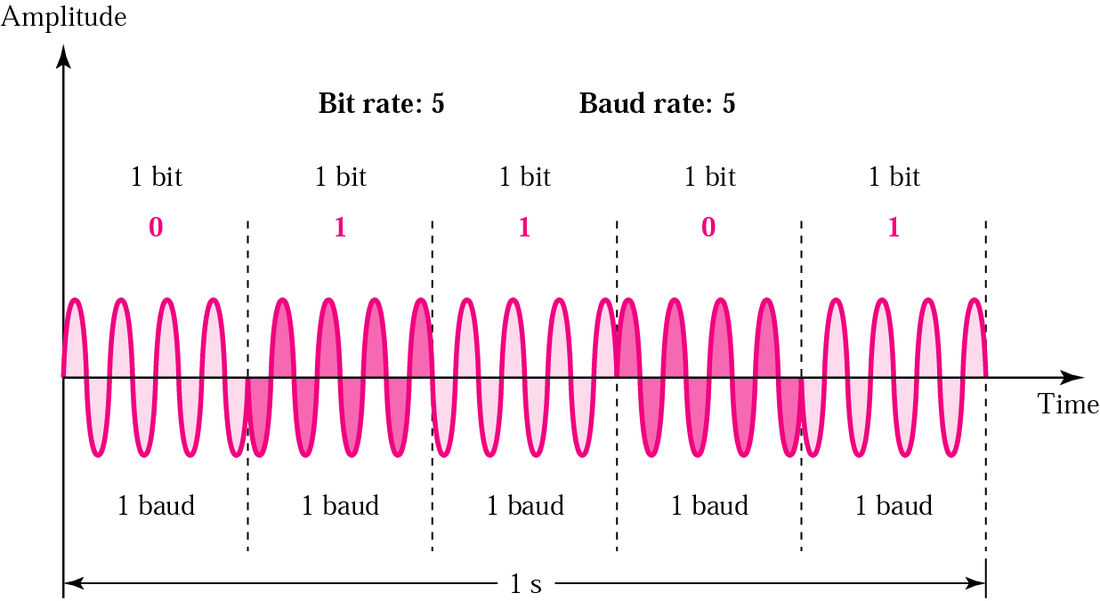
Figure 5.8 PSK

Slide 45
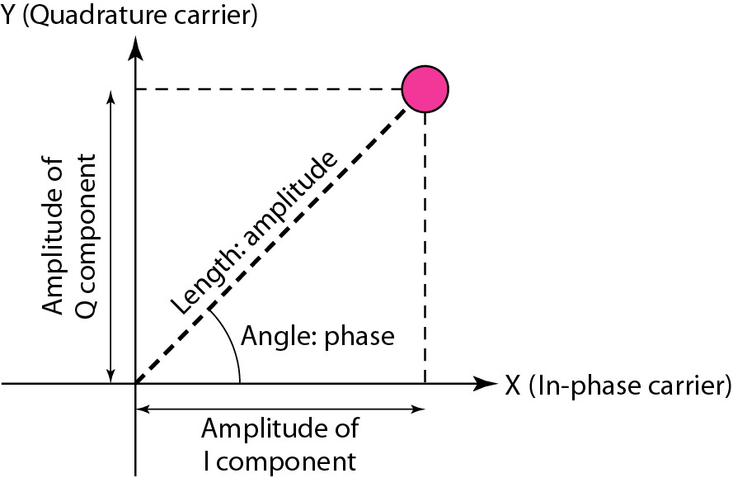
Figure 5.12 Concept of a constellation diagram

Slide 46
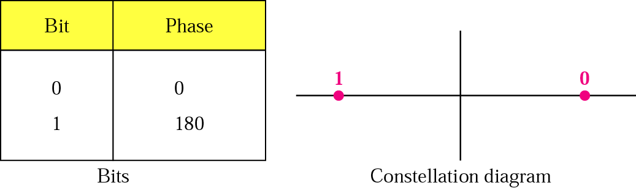
Figure 5.9 PSK constellation

Slide 47
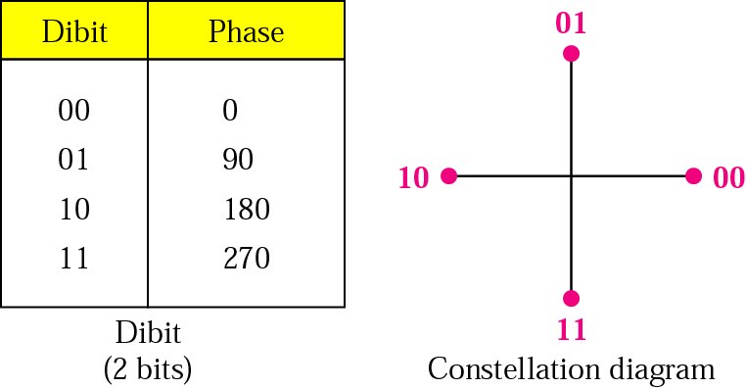
Figure 5.11 The 4-PSK characteristics

Slide 48
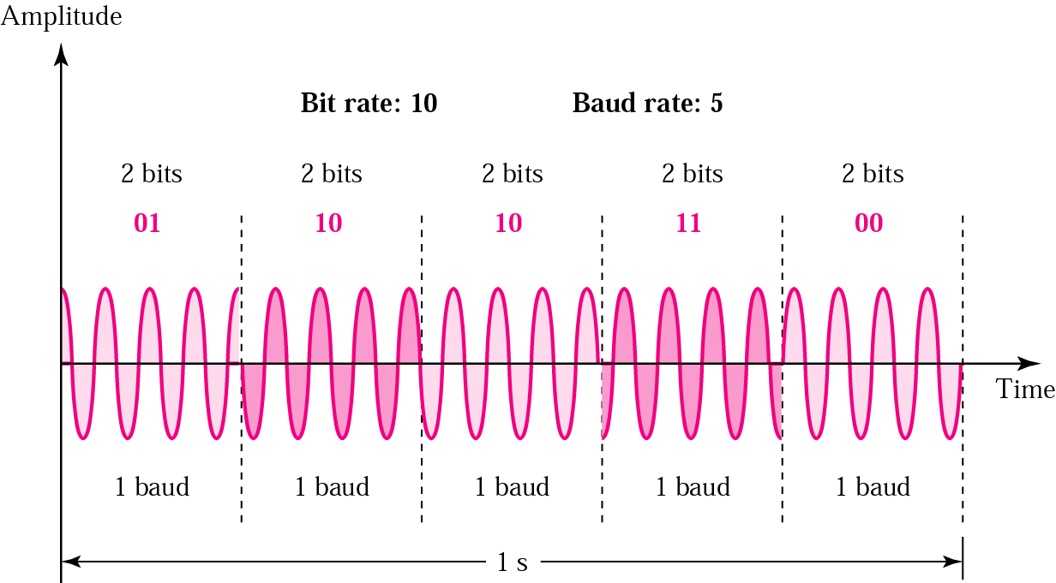
Figure 5.10 The 4-PSK method

Slide 49
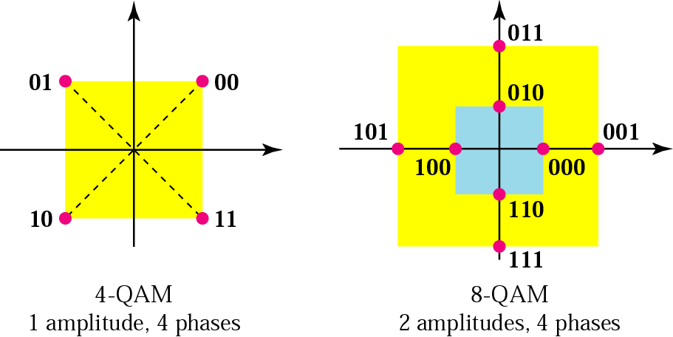
Figure 5.14 The 4-QAM and 8-QAM constellations

Slide 50
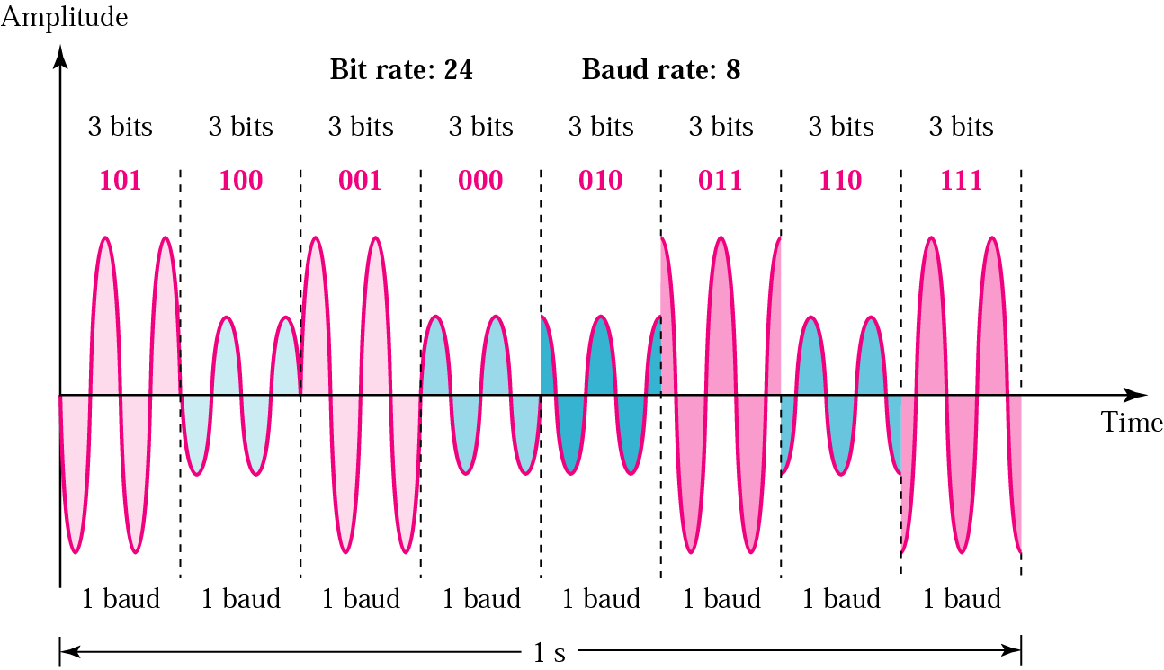
Figure 5.15 Time domain for an 8-QAM signal

Slide 51
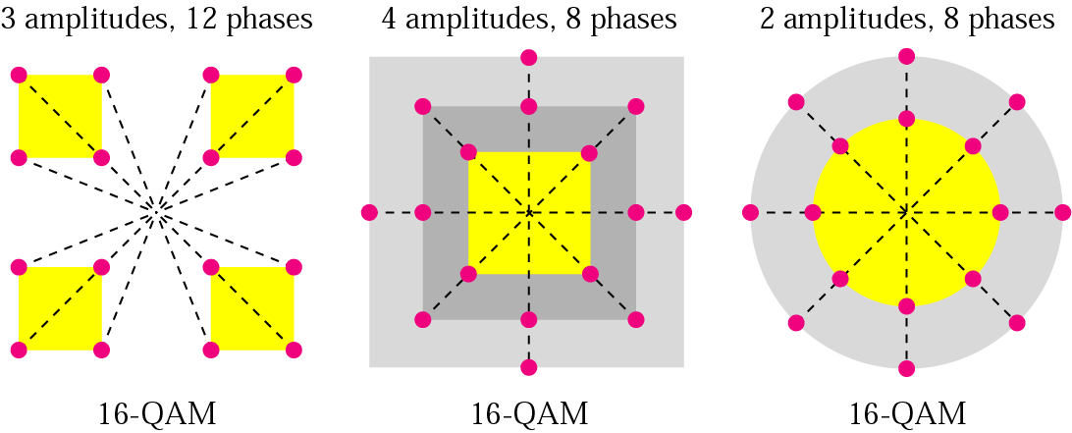
Figure 5.16 16-QAM constellations

Slide 52
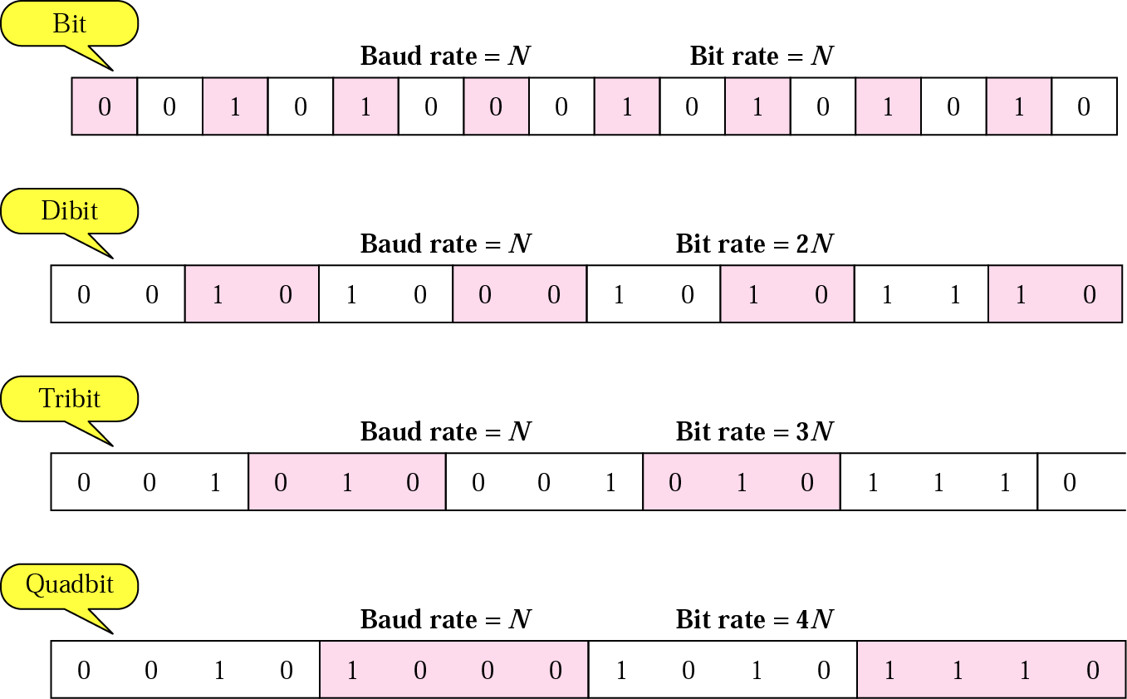
Figure 5.17 Bit and baud

Slide 53
Figure 5.14 The 4-QAM and 8-QAM constellations

Slide 54
Figure 5.15 Time domain for an 8-QAM signal

Slide 55
Figure 5.16 16-QAM constellations

Slide 56
Figure 5.17 Bit and baud

Slide 57
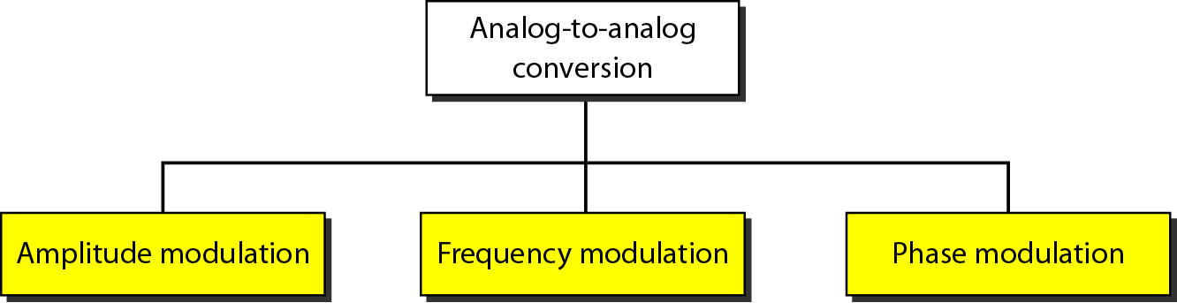
Analog-To-Analog Conversion

Slide 58
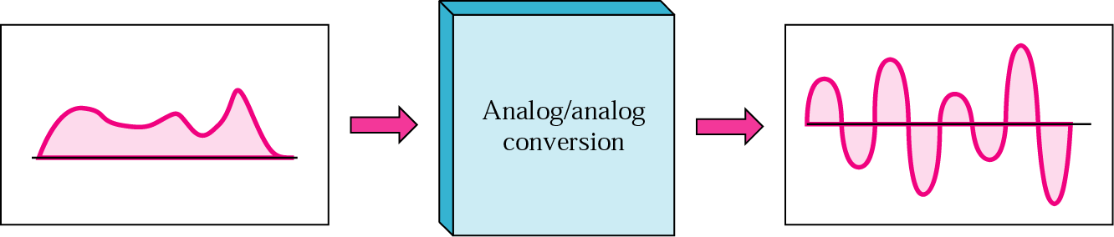
Figure 5.24 Analog-to-analog modulation

Slide 59
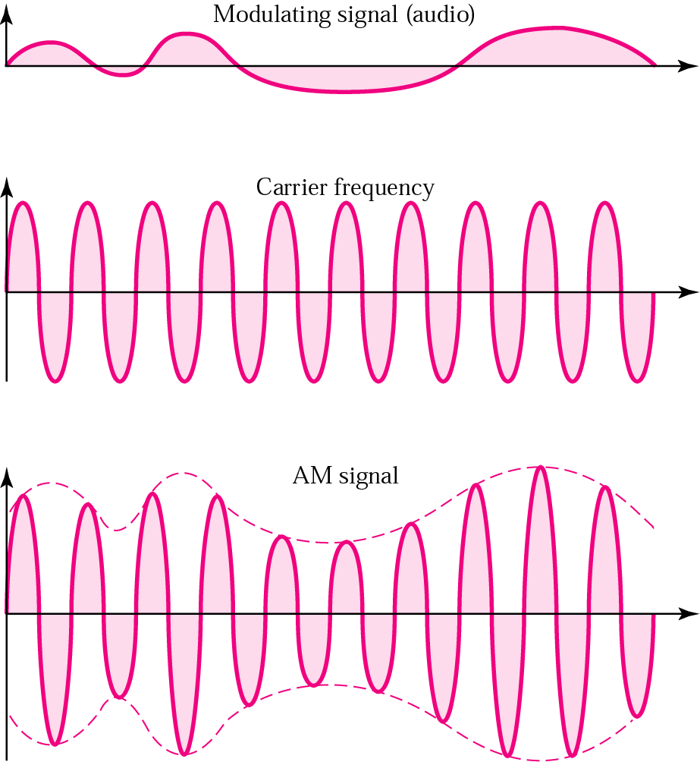
Figure 5.26 Amplitude modulation

Slide 60
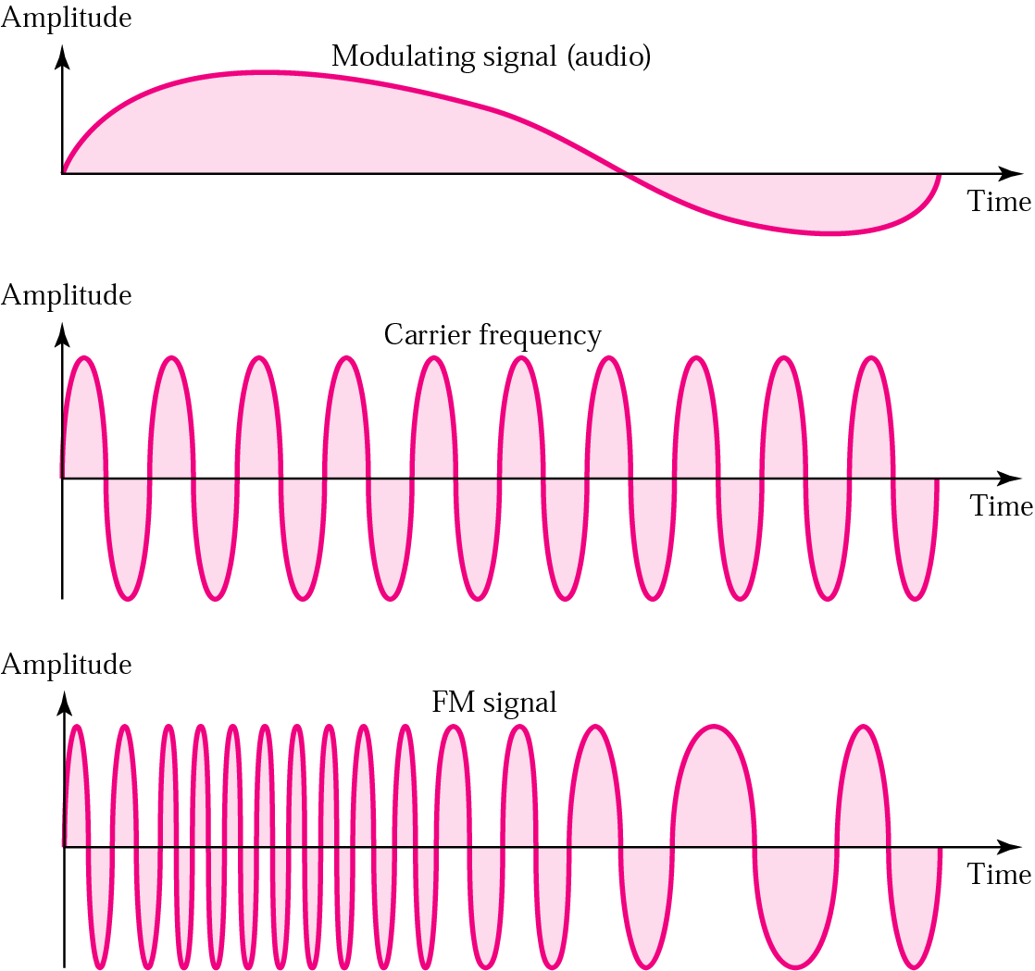
Frequency modulation (FM)

Slide 61
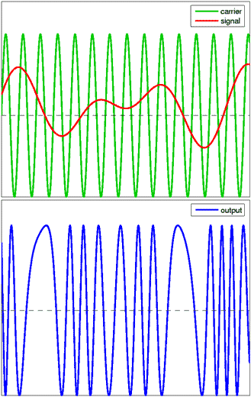
Phase Modulation (PM)
Notes:
Unlike its more popular counterpart, frequency modulation (FM), PM is not very widely used for radio transmissions.
This is because it tends to require more complex receiving hardware and there can be ambiguity problems in determining whether, for example, the signal has changed phase by +180° or -180°.
PM is used, however, in digital music synthesizers
ASK. Simple and cheap
FFSK. Reliable and very good BER
PSK has a higher speed but perhaps is more difficult adjustment if you are using links between your different stations.

Slide 62
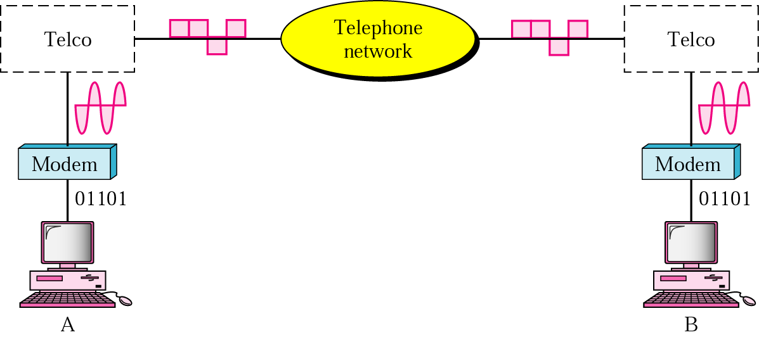
Figure 5.19 Modulation/demodulation

Slide 63
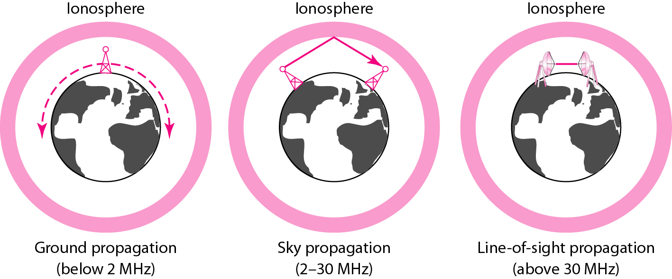
Figure 7.18 Propagation methods

Slide 64
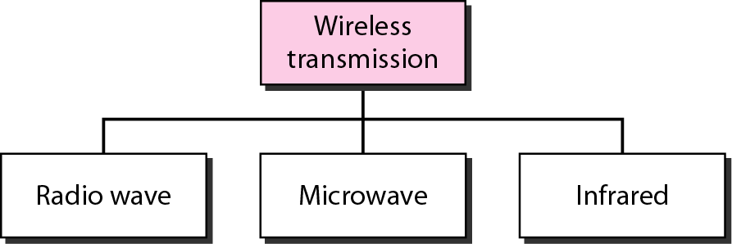
Figure 7.19 Wireless transmission waves

Slide 65
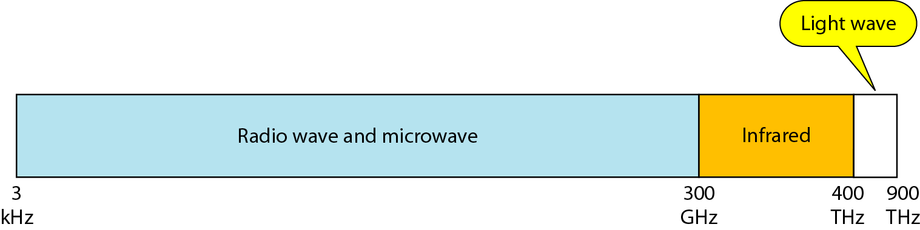
Figure 7.17 Electromagnetic spectrum for wireless communication
1 GHz

Slide 66
Summary
Digital data to digital signal
Line coding
RZ, NRZ, Machester, AMI, …
Block coding: mB/nB
Scrambling: B8ZS, …
Analog data to digital signal
PCM, DM
Digital data to analog signal
ASK, FSK, PSK, QAM
Analog data to analog signal
AM, FM, PM

